Slide 1

Fabrication of graphitic-carbon suspended nanowires through mechanoelectrospinning of photocrosslinkable polymers
A Osamu Katagiri Tanaka osamu.katagiri@exatec.tec.mx
Assessors:
Héctor Alán Aguirre Soto <alan.aguirre@tec.mx>
Dora Iliana Medina Medina <dora.medina@tec.mx>
30 Jan 2020

Slide 2
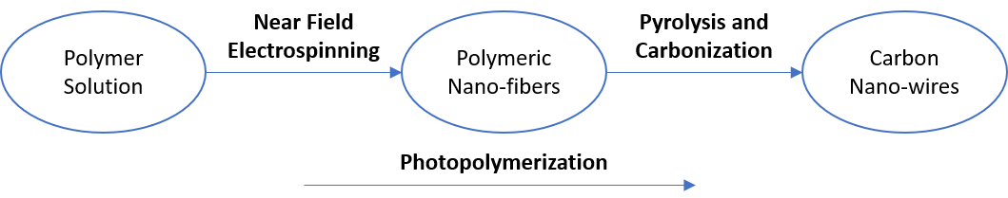
Thesis Overview
Design polymer solutions that can be electrospun by NFES, photopolymerized, and then pyrolyzed into carbon nano-wires.

Slide 3
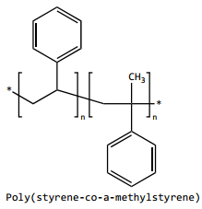
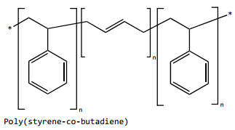
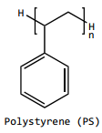
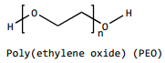
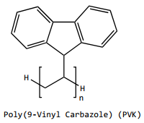
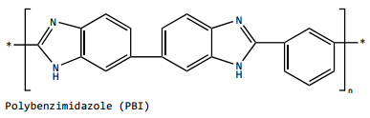
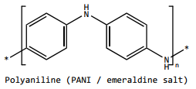
Discover a new polymer solution to beat Braulio’s record
Study solutions with high carbon polymers and no oxygen.
No records
in THF & DMF
in THF
SU-8
+
v.s.
● FFES
● NFES
No records
in NMP
in Styrene

Slide 4
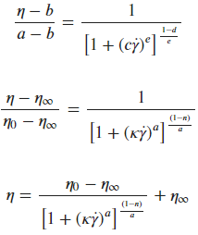
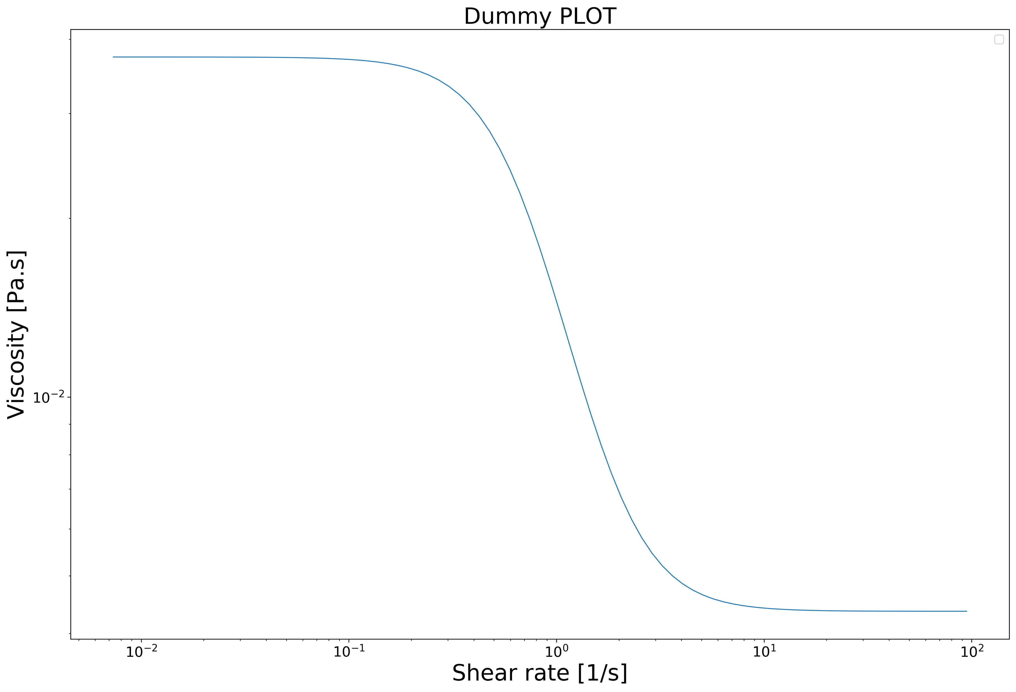
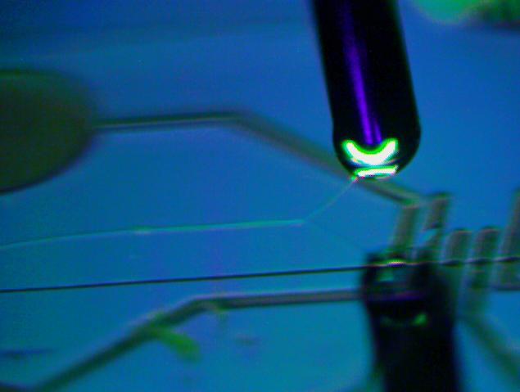
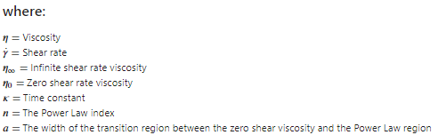
The Carreau-Yasuda Model [1]
zero shear rate viscosity
power law region
infinite shear rate viscosity
[1] Osswald, T., Rudolph, N., Osswald, T., & Rudolph, N. (2014). Generalized Newtonian Fluid (GNF) Models. Polymer Rheology, 59–99. https://doi.org/10.3139/9781569905234.003

Slide 5
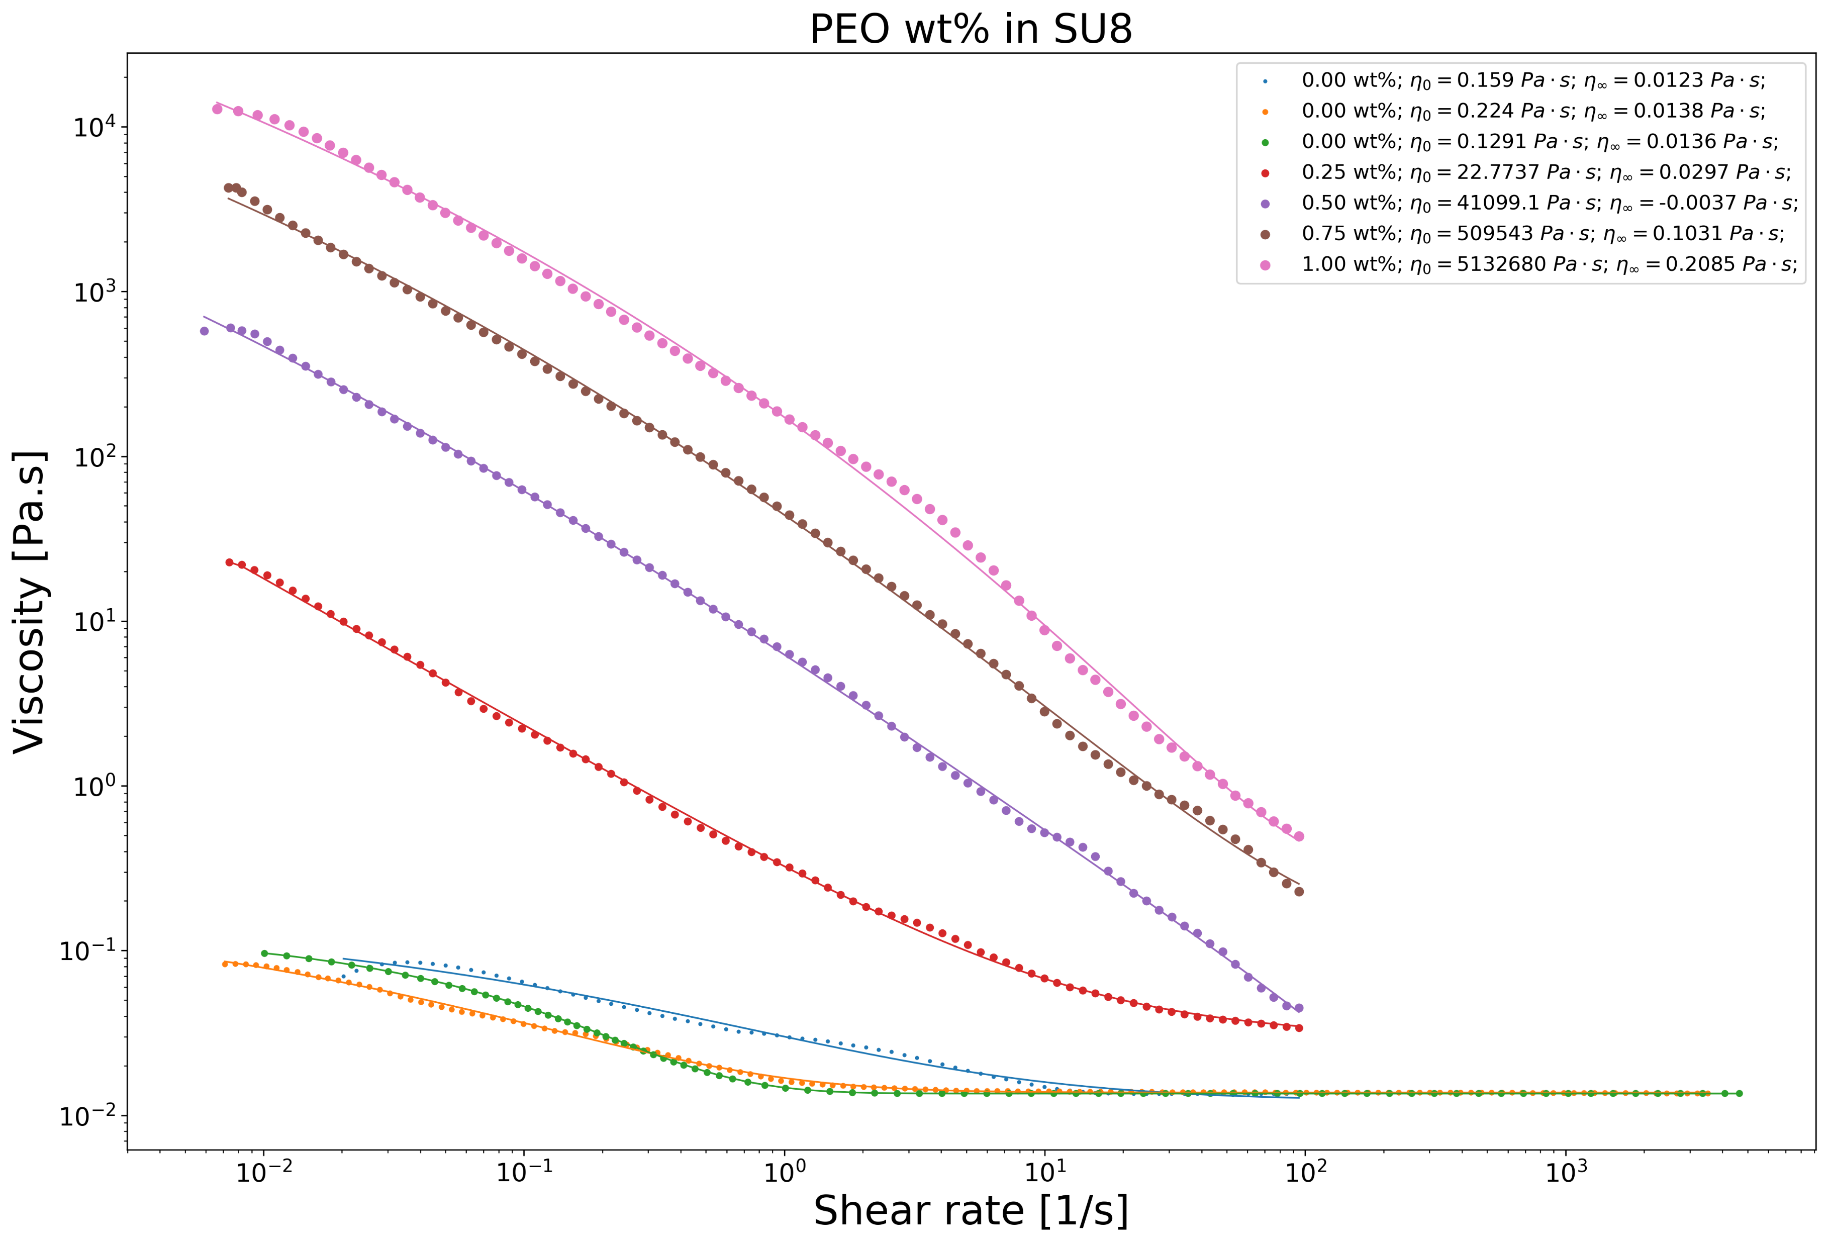
~4.87 μm diameter fibers [2]
~4.68 μm diameter fibers [2]
~4.35 μm diameter fibers [2]
SU-8 +
~1.58 μm diameter fibers [2]
no successful depositions of pure SU-8 [2]
Flores, D. R. (2017). Role of rheological properties in near field electrospun fibers morphology, 130.

Slide 6
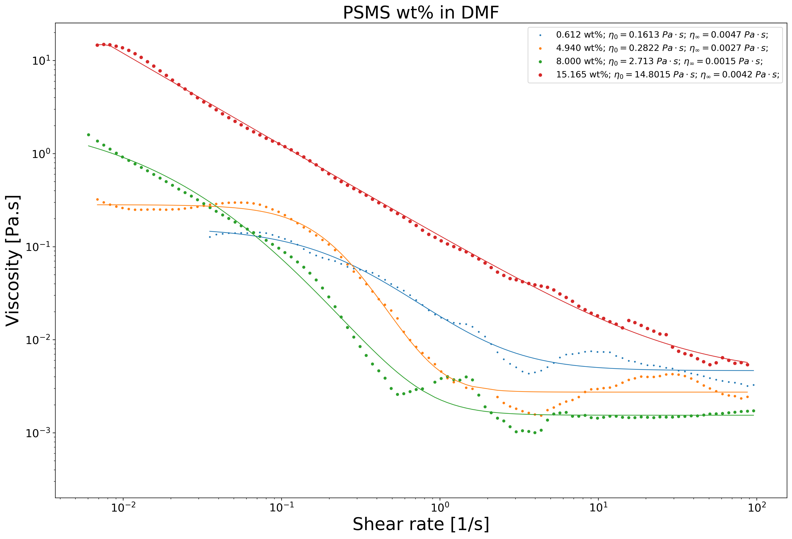

Slide 7
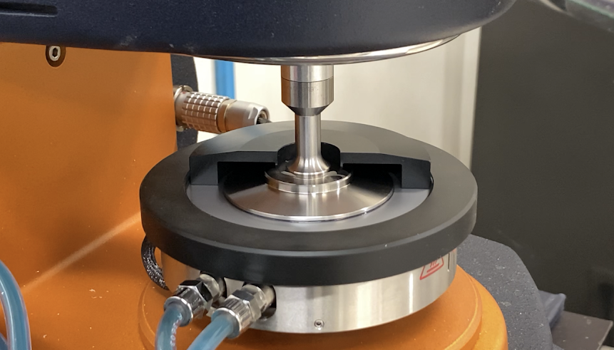

Slide 8
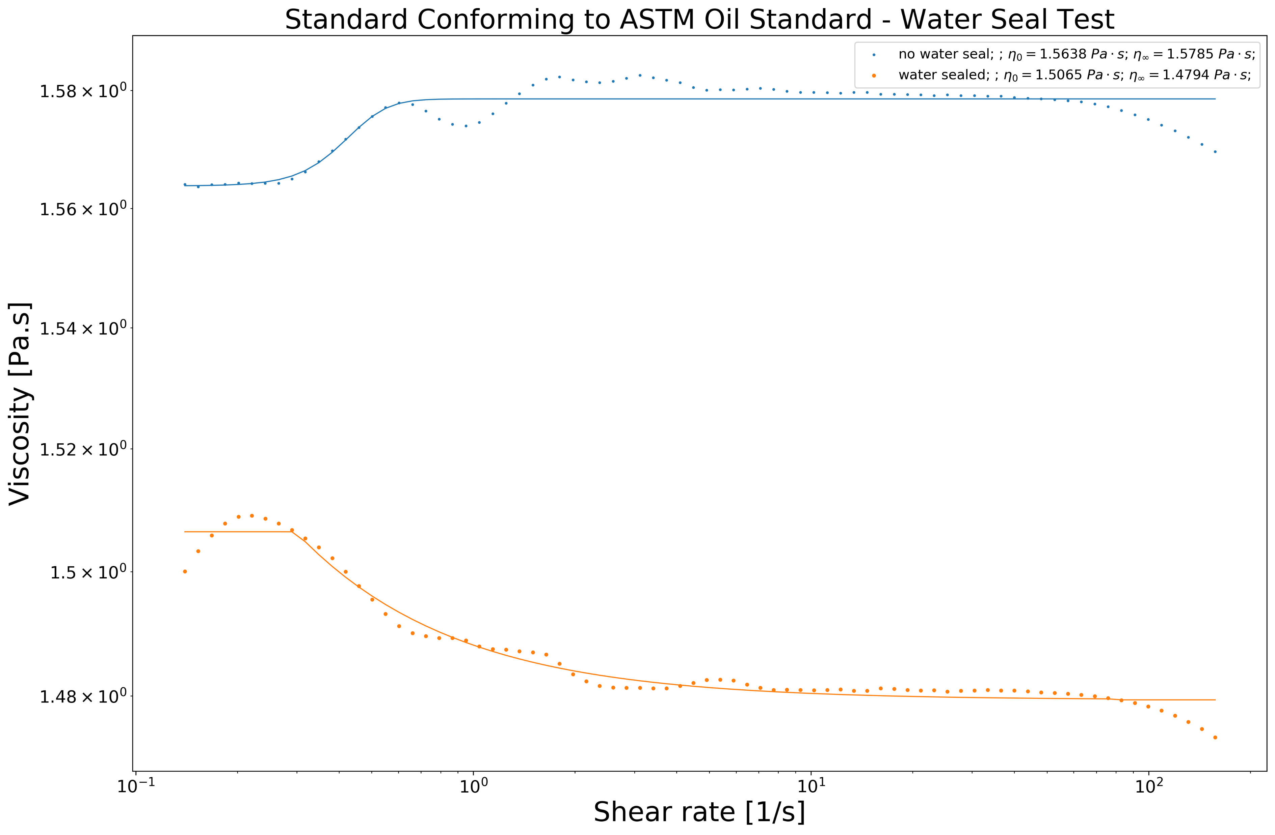
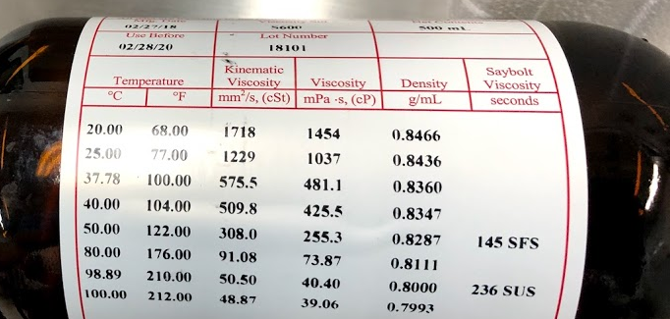

Slide 9

Q&A

Slide 10
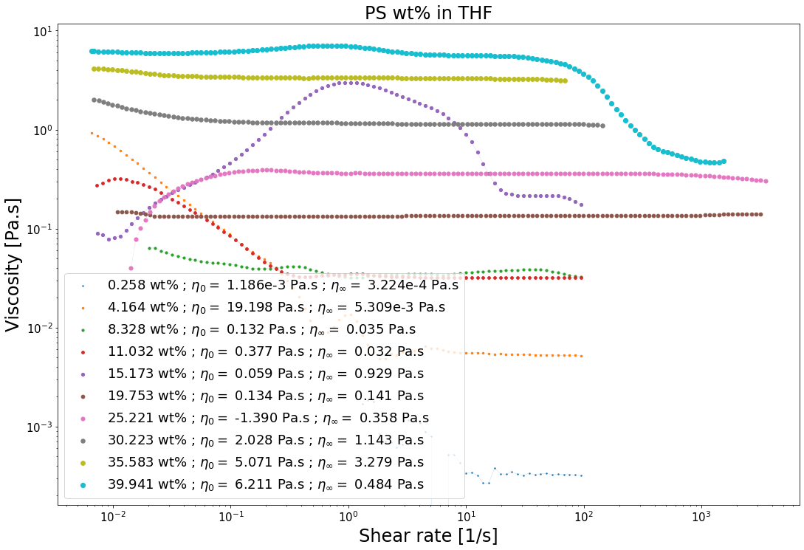

Slide 11
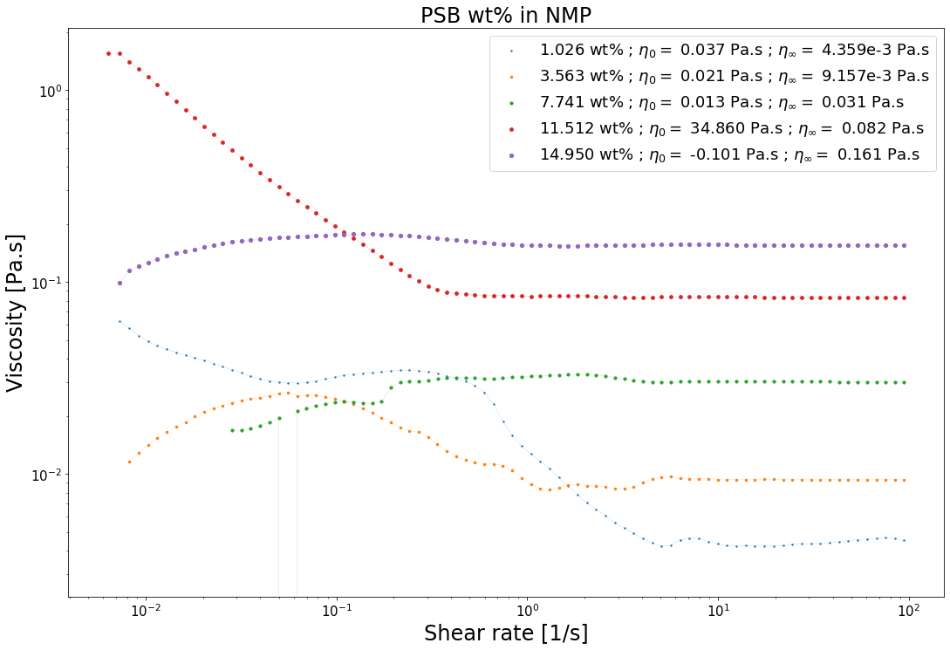

Slide 12
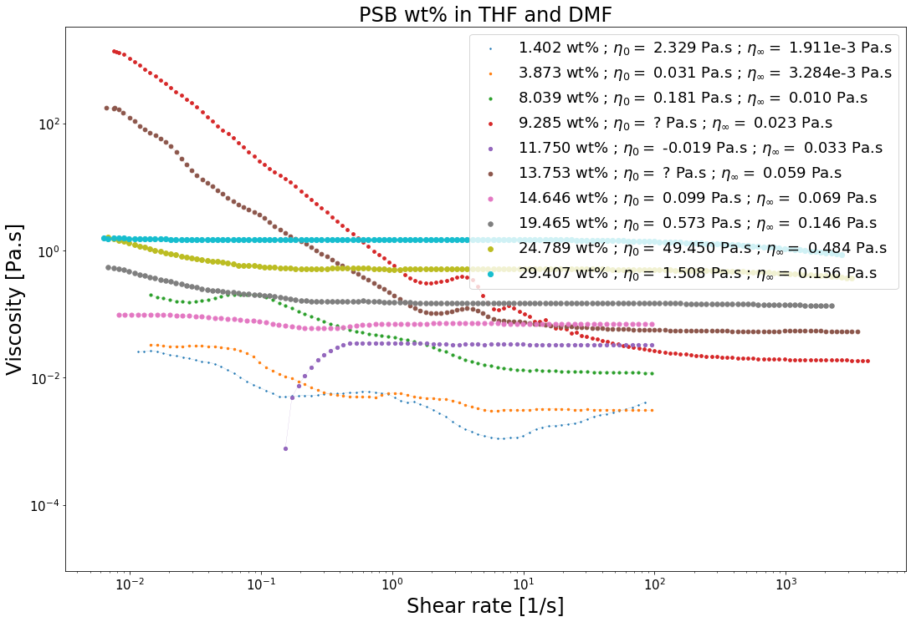

Slide 13
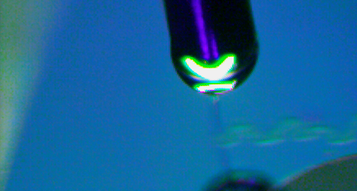
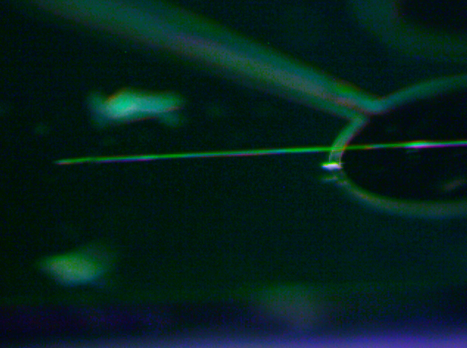
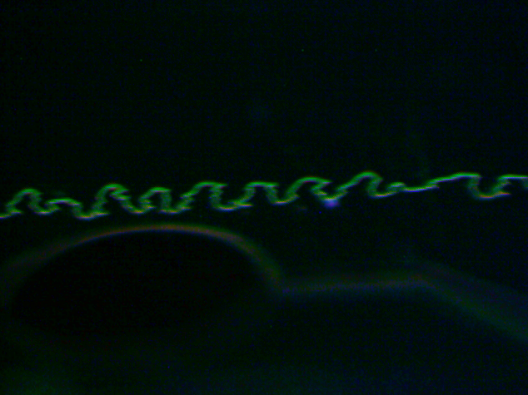
Characterization of the 0.25 wt% PEO Solution
Electrospun-able with an applied voltage of 600V.
Unable to initiate the jet at 500V or lower.
600V
700V
Notes:
Surface t-

Slide 14
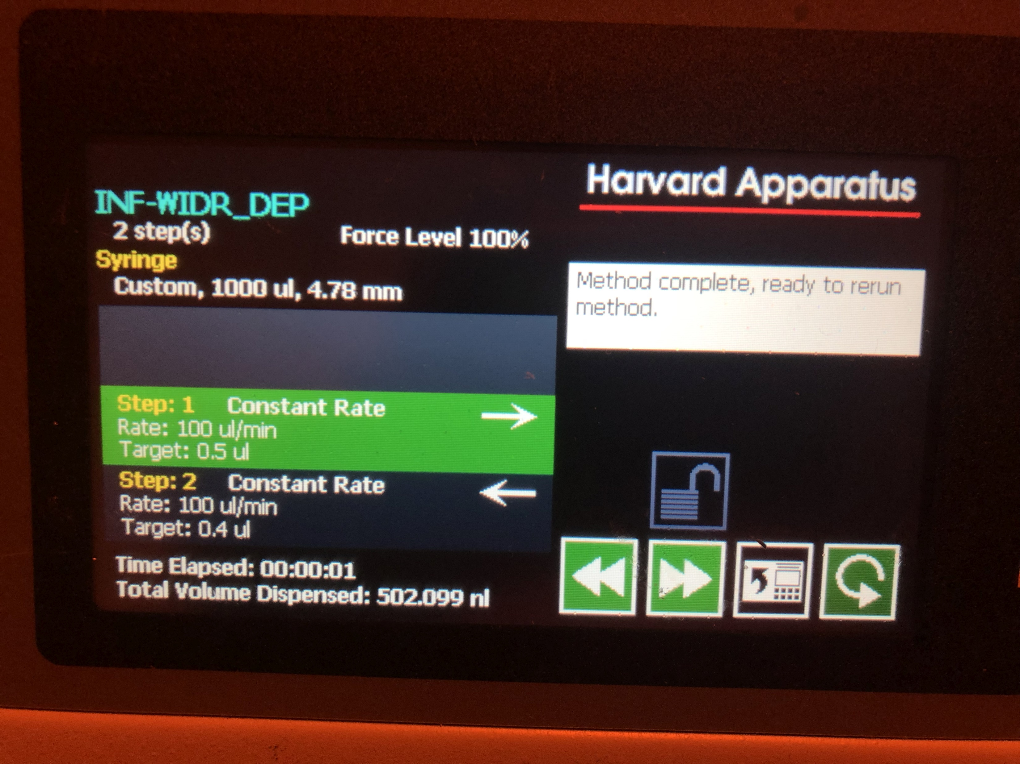
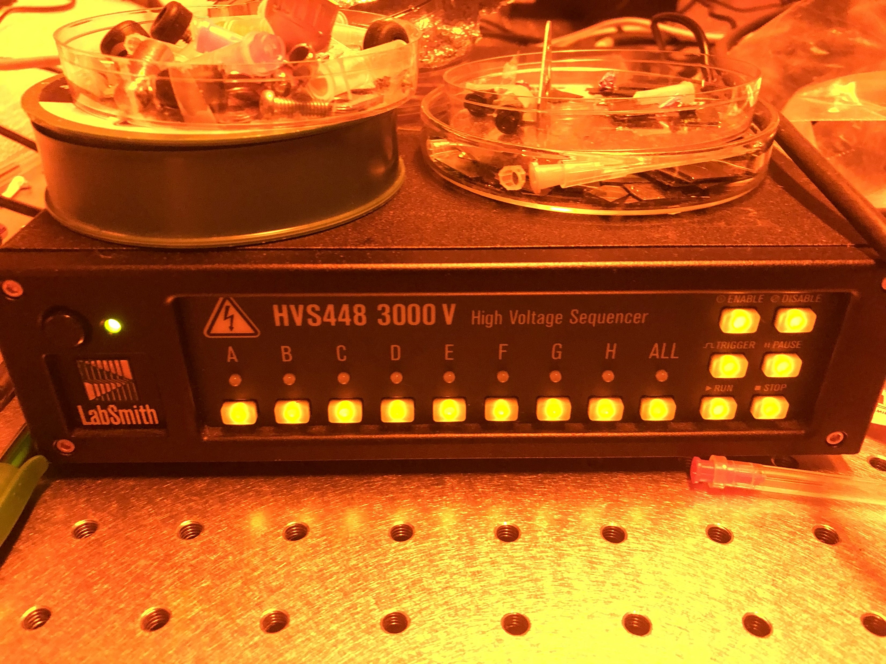
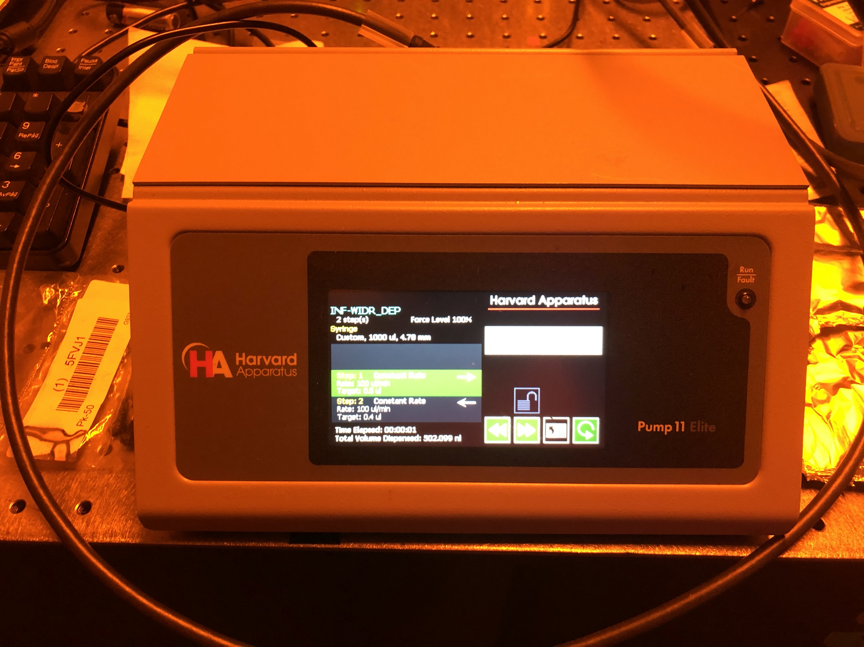

Slide 15
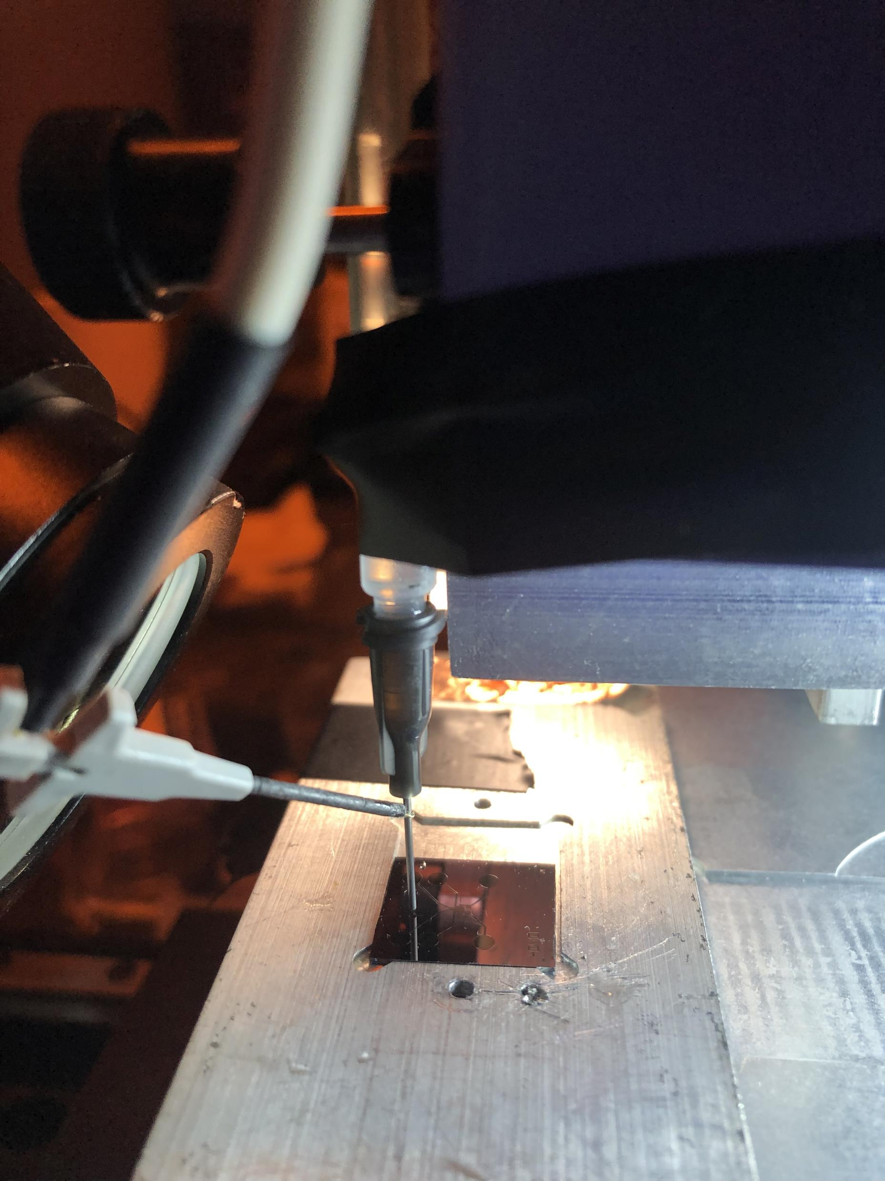
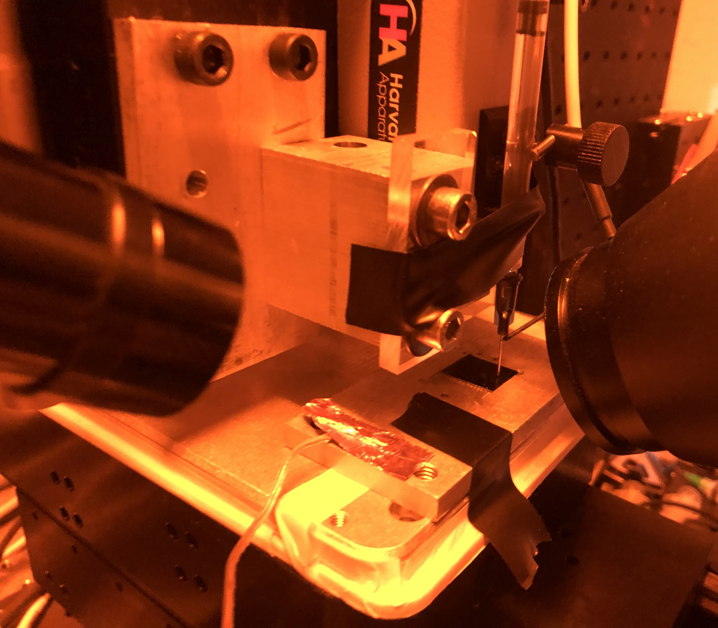

Slide 16
PEO Solution
The EMS polymer solution consisted of
2ml of SU-8 2002 mixed with
0.5 wt% of Poly(ethylene oxide) (PEO, 4,000,000 MW; SigmaAldrich Inc., Cat. N. 189464) and
0.5 wt% Tetrabutylammonium Tetrafluoroborate salts (TBATFB; SigmaAldrich Inc., Cat. N. 217964) to increase its conductivity and allow smooth polymer flow during electrospinning.
All reagents were used as received. Magnetic stirring of these components was performed for 1hr at 75°C and low rpm (100-150 rpm).

Slide 17
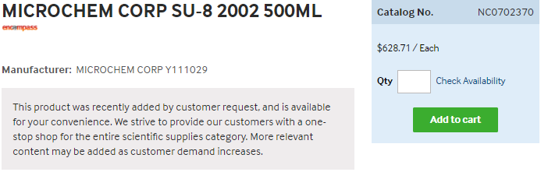
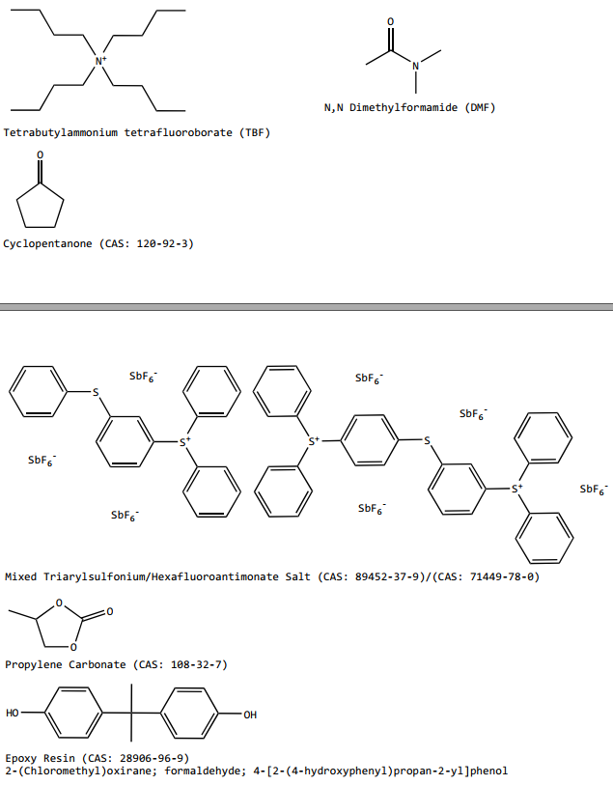
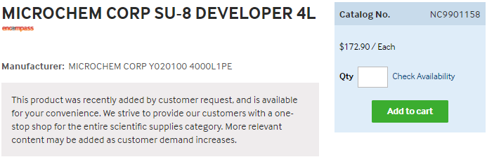
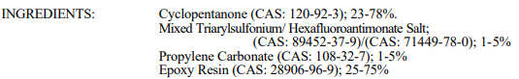
https://www.fishersci.com/shop/products/NC0702370/nc0702370#?keyword=MICROCHEM+CORP+PHOTORESIST+SU-8
https://www.fishersci.com/shop/products/NC9901158/nc9901158#?keyword=SU-8++developer
Notes:
https://rsc.aux.eng.ufl.edu/_files/msds/309.pdf

Slide 18
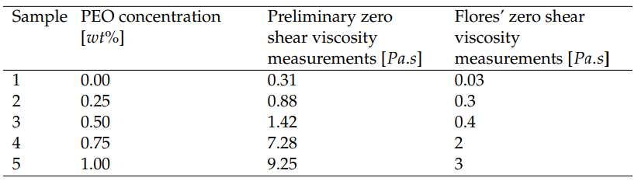
Zero shear viscosity measurements and Flores’ measurements
Both measurements have the same behaviour with similar proportions.
However, the results show that the current measured values are approximately three times larger than Flores’ measurements.

Slide 19
<subTitle>
<content> <key concept>

